Slide 1

Fruit Plant Disease Detection with Deep Learning
Leveraging deep learning techniques to accurately classify plant diseases from leaf images for early detection and intervention.
Muhammad Adeel
Saud Khan

Slide 2




INTRODUCTION
Motivation
Combat plant diseases effectively
Combat plant diseases effectively to enhance crop health and agricultural productivity.
Enable early detection and prompt intervention to prevent the spread of diseases and mitigate crop losses.
Classify plant diseases from leaf images
Enhance crop health and productivity
Develop a deep learning model to accurately classify plant diseases by analyzing images of diseased and healthy plant leaves.
Reducing the impact of plant diseases, will promote crop health quality, and yield, leading to improved agricultural productivity.
Primary goal and motivation behind the plant disease detection project, highlighting its potential to combat plant diseases effectively and enhance crop health and productivity through accurate classification of diseases from leaf images.

Slide 3

OBJECTIVES OF THE PROJECT
Develop a Deep Learning Mode: Create a deep learning model capable of accurately classifying plant diseases from images of leaves.
Enhance Early Detection: Improve early detection thus, minimizing the spread and impact of plant diseases.
Crop Yield Improvement: Contribute to crop yield and agricultural productivity by enabling timely identification and management of plant diseases.
Enable Sustainable Agriculture : Support sustainable farming practices by minimizing the use of pesticides through targeted disease management.
Address Challenges of Manual Method: Address the challenges associated with manual disease detection methods, such as subjectivity and inefficiency

Slide 4

Dataset Description
Dataset
Contents
Classes
New Plant Diseases Dataset
87,000 RGB images of healthy and diseased plant leaves.
38 distinct classes representing various plant species and diseases.
Preprocessing
Partitioning
Augmentation to increase dataset size and diversity.
The dataset is partitioned into training and validation sets maintaining an 80/20 split.

Slide 5
In this project we use three Neural Network
CNN,VGG16,ResNet34
CNN Model
A custom Convolutional Neural Network (CNN) tailored specifically for plant disease classification.
KEY POINTS
We fine-tuned the parameters of the custom CNN, ensuring optimal performance in identifying plant diseases.
We designed a CNN architecture with 10 convolutional layers, followed by ReLU activation functions and Max-Pooling layers.
The Model is designed to extract hierarchical features from images, followed by fully connected layers for classification.
This serves as the base model for the ensemble model.

Slide 6
VGG16
INTRODUCTION
VGG16 model, a pre-trained deep CNN model, originally developed for image classification tasks.
KEY POINTS
VGG16 consists of 16 layers with a uniform architecture, characterized by multiple convolutional and pooling layers.
VGG16 is known for its deep architecture and simplicity, making it an effective choice for various image classification tasks.
The VGG16 model is used as another component of the ensemble model.

Slide 7
ResNet34
INTRODUCTION
ResNet34 pre-trained model was employed, a variant of Residual Neural Network architecture.
KEY POINTS
ResNet34 consists of 34 layers and is renowned for its skip connections, which mitigate the vanishing gradient problem and enable the training of deeper networks.
ResNet34's skip connections allow for the training of deeper networks without encountering the degradation problem, resulting in improved accuracy
ResNet34 model is used as another component of the ensemble.

Slide 8
Ensemble Approach
In our pursuit of optimizing plant disease classification, ensemble strategy was employed, leveraging the outputs of multiple models to enhance overall accuracy and robustness.
KEY POINTS
Ensemble Strategy: We combined the predictions of three distinct models.
Models used:
Custom CNN: Tailored specifically for in-depth feature extraction, providing unique insights to the ensemble.
VGG16: Brought its own set of learned features and capabilities to the ensemble.
ResNet34: Addressed the vanishing gradient problem in our ensemble.

Slide 9
ADVANTAGES OF ENSEMBLE APPROACH
Improved Accuracy
By ensembling multiple models, we were able to leverage the strengths of each architecture, resulting in enhanced classification accuracy.
Robustness
The ensemble approach helped mitigate individual model biases and errors, leading to a more robust and reliable classification system.
Reduction of Overfitting
The Ensemble methods help reduce overfitting by combining multiple models' predictions.

Slide 10
MODEL IMPLEMENTATION
Preprocessing
Preparing the dataset involved steps such as Data Augmentation,
Data preprocessing, Dataset Splitting, and Data loading and batching.
Data Augmentation: To increase the diversity of training dataset.
Data Preprocessing: Resizing images to 128x128 pixels size and converting them to PyTorch tensors.
Dataset Splitting: 'random_split' function from PyTorch was used for random split of dataset to training and validation data.
Data Loading and Batching: DataLoader from PyTorch was used for batching, shuffling, and parallelizing data loading

Slide 11
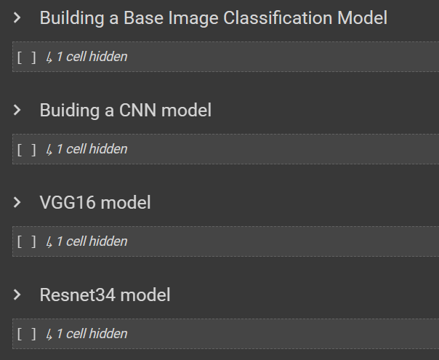
Building the model

Slide 12
Training Procedure and Hyperparameters
1
Number of Epochs
2
Iterative Training Cycles:
The Number of Epochs used for training dataset were 15.
Iterating over the dataset across multiple epochs, (since data was divided into batches) computing loss and updating weights to minimize it.
3
Adam Optimizer:
4
Hyperparameter Tuning:
Adam optimizer with a learning rate of 0.001 offers adaptive learning rates and faster convergence, crucial for efficient training.
The optimizer adjust model’s parameters to minimize loss using backpropagation.
Overall, this method enhances classification accuracy and robustness by the strengths of Adam optimizer in deep learning applications.

Slide 13
Evaluation Results
Accuracy
F1-score:
Measures overall correctness of classification.
Harmonic mean of precision and recall,.
Precision
AUC-ROC Score:
Proportion of true positive predictions among all positive predictions.
Evaluates model performance across different thresholds and class imbalances.
Recall
The proportion of actual positive cases that were correctly identified by the model.

Slide 14
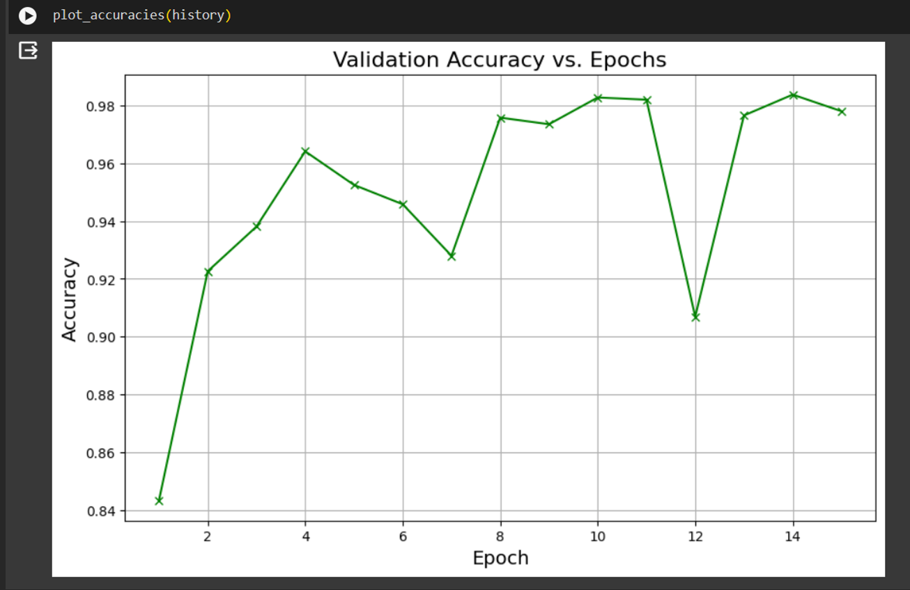
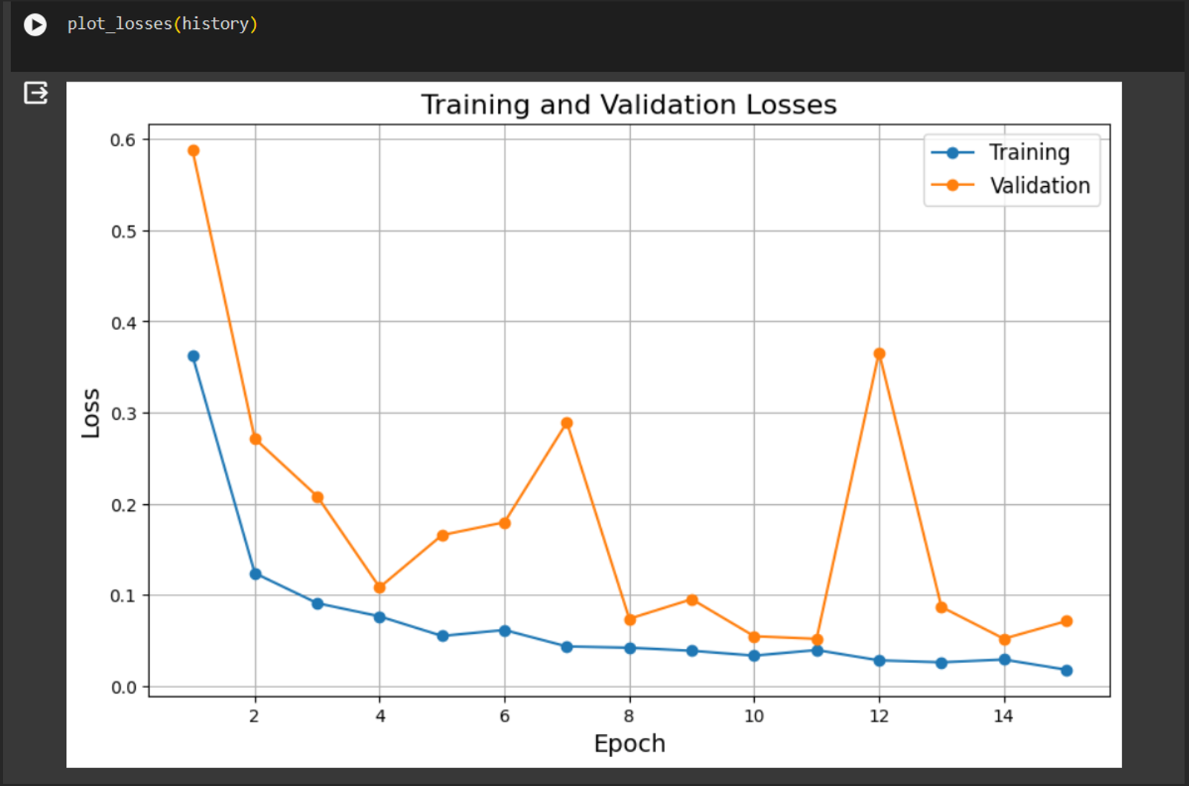
Accuracy
and
Validation Losses

Slide 15
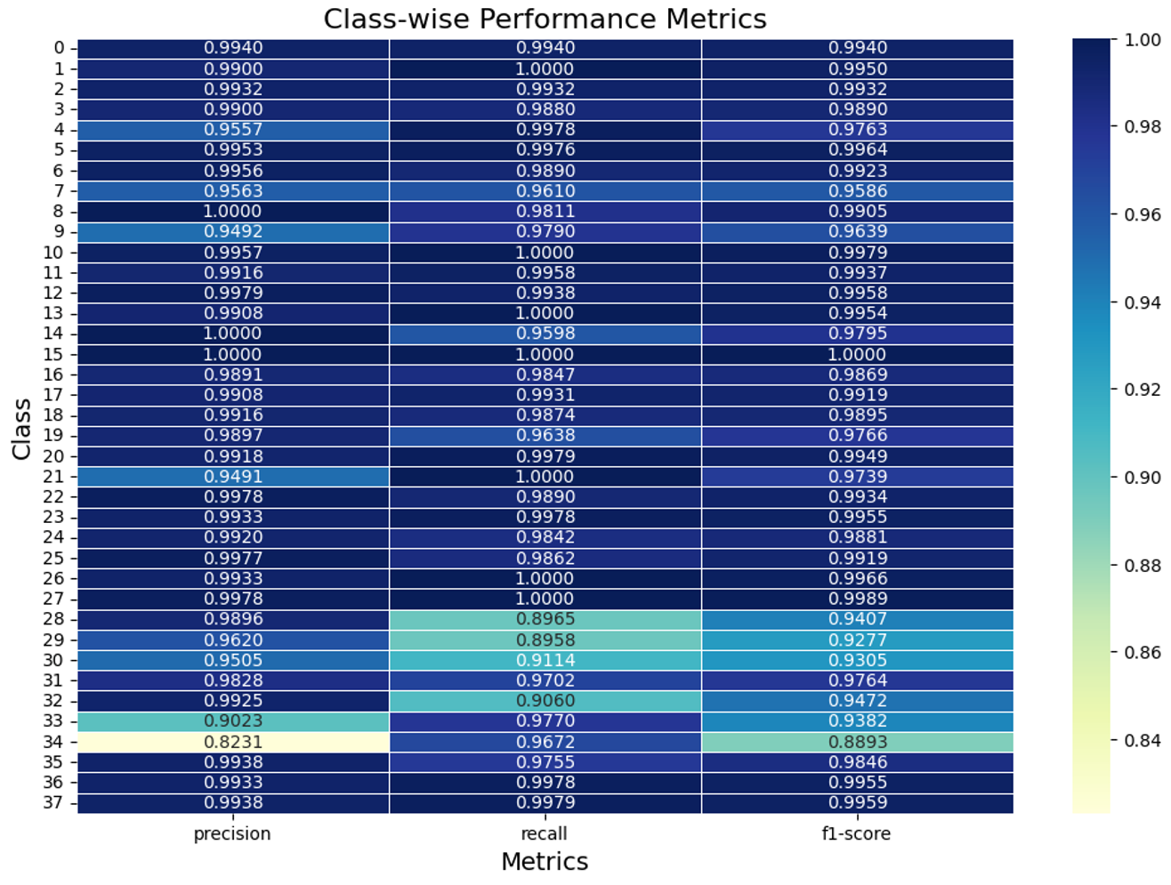
Class-wise Performance Metrics for Precision, Recall and F1-score

Slide 16
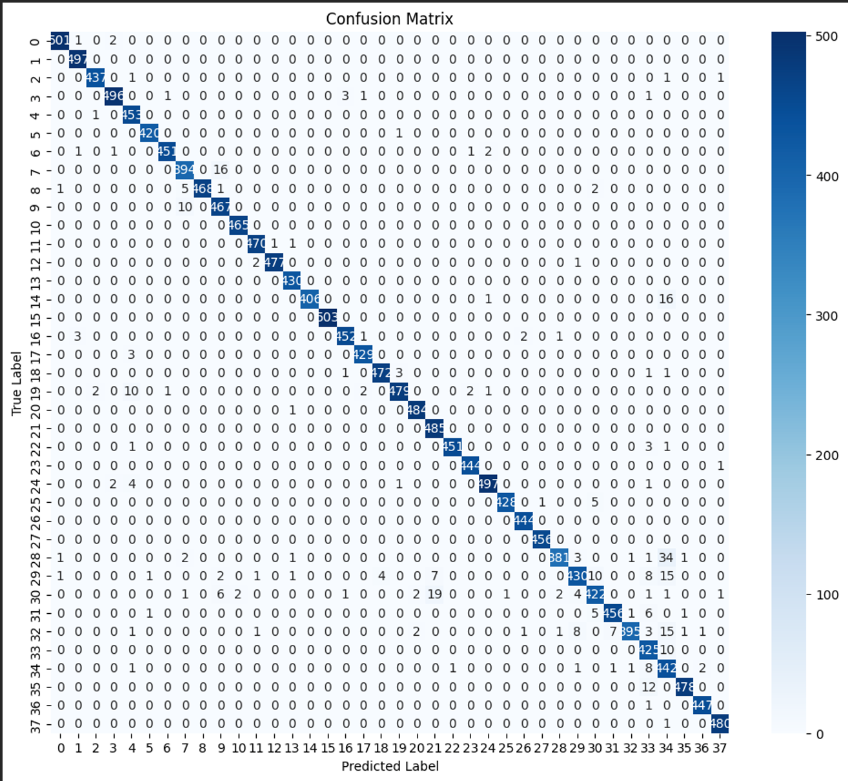
Confusion Matrix
High values on the diagonal, means the model is making correct predictions for the specific class.
Off-diagonal values suggests the model is making some mistake

Slide 17
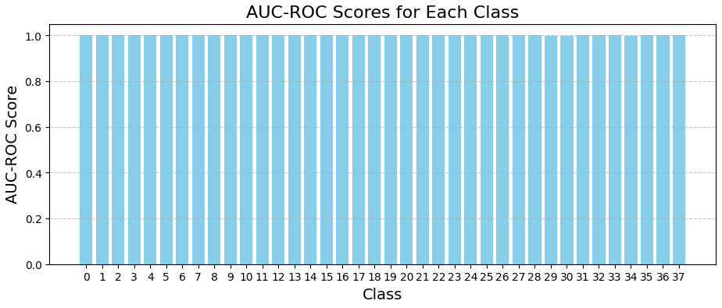
AUC-ROC Score
Measures model performance across different thresholds and class imbalances.
With every following class, we could see minimal imbalance between classes thus proving perfect distribution

Slide 18
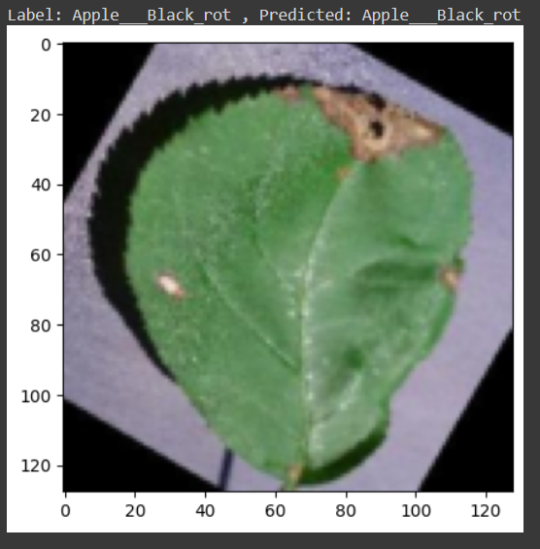
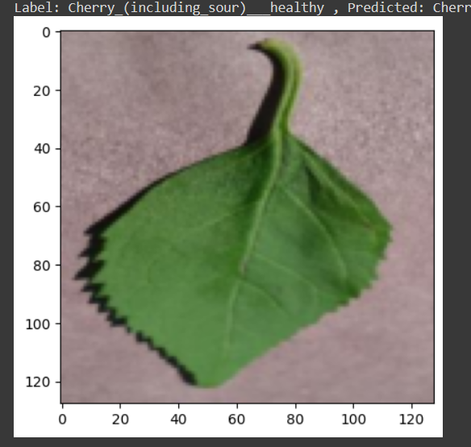
Prediction on some single image
Label: Apple Black rot
Predicted: Apple Black rot
Label: Cherry (including sour) healthy Predicted: Cherry (including sour) healthy

Slide 19
OUTCOMES
Valuable
Potential
High Accuracy in identification plant disease.
Valuable tool for early disease detection and efficient crop management.
Potential to significantly augment agricultural practices.
PROJECT
CONCLUSION
Continued Improvement
Continued Improvement
GUI to empowers farmers to effortlessly upload images of plant leaves.
Train model over range of plant data classes to enhance its adaptability and effectiveness.

Slide 20

THANK YOU FOR YOUR TIME

